Slide 1
Efficiency in Replit 8.4 Game
GOALS
1) eliminate while loops with multiple OR conditions
2) prevent results from outputting multiple times
3) return appropriate result to users regardless of case of input
Week 1 Presentation - Matthew Goninen
4) continue running code until the user wins the game

Slide 2
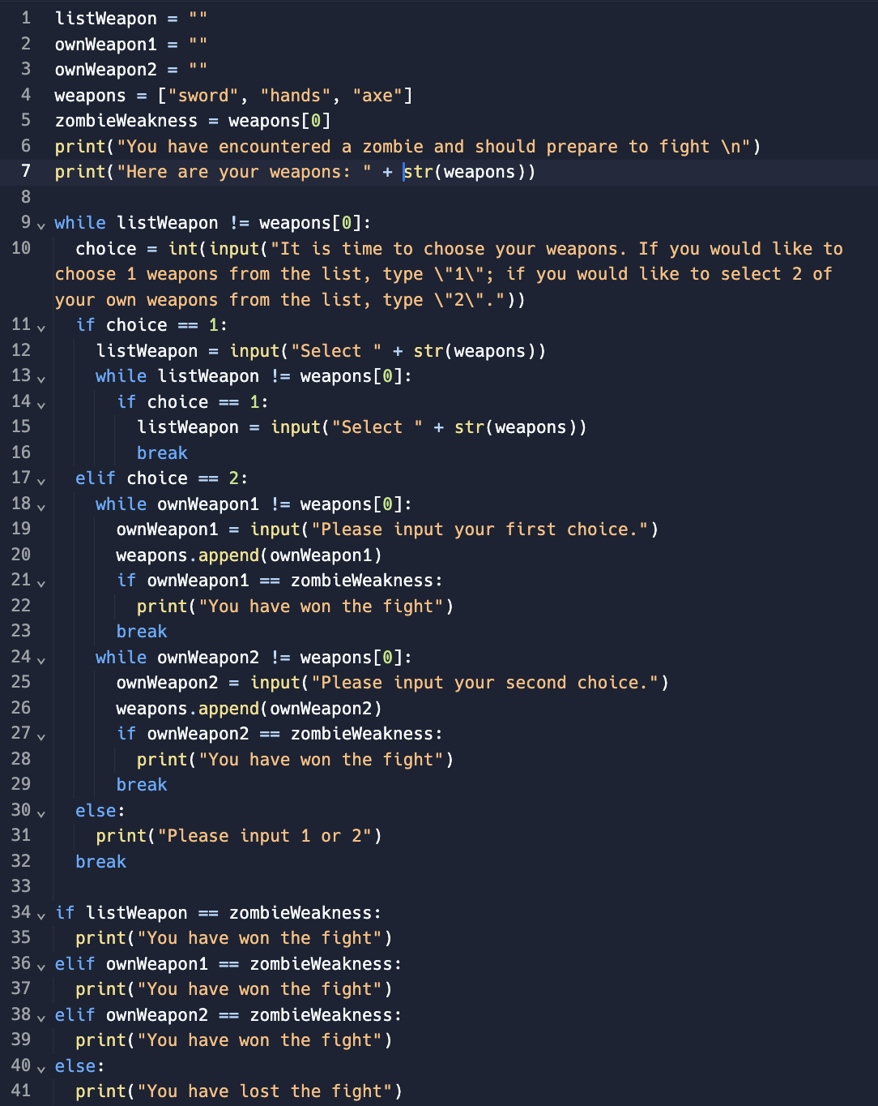

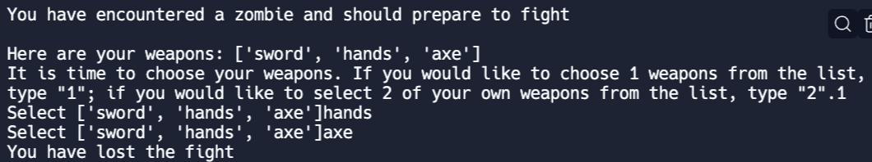

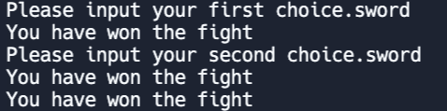
Original Code
Problems:
Multiple Nested While Loops are Hard to Follow and Inefficient
Results are Outputted Multiple Times
Input was case sensitive
Code would occasionally stop running even if the user has not yet won

Slide 3
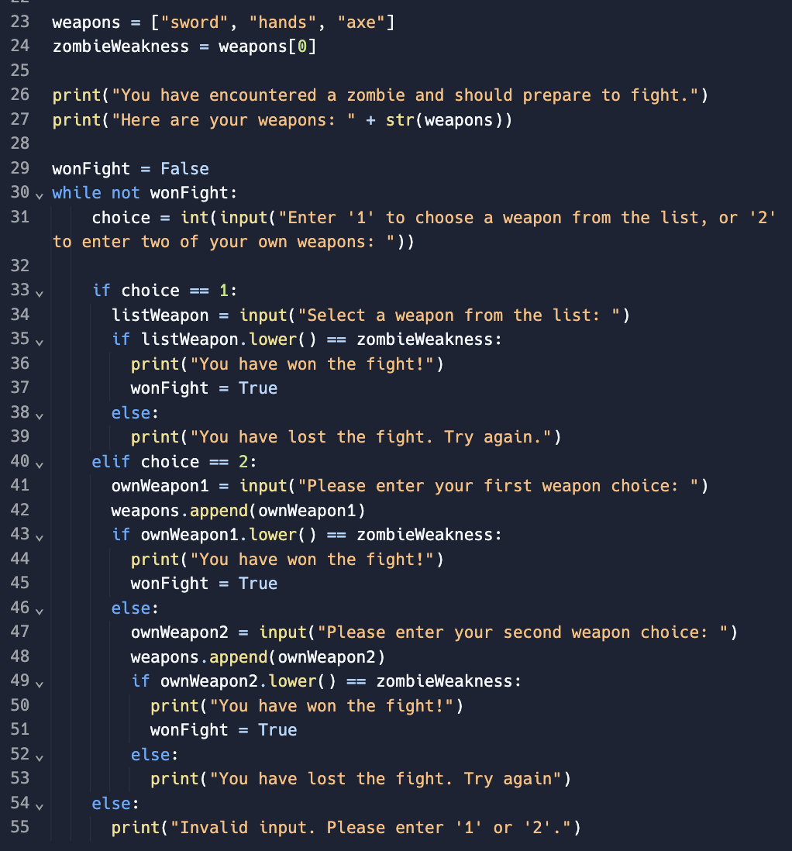



New Code
Solutions:
Nested While Loops are Replaced by a Boolean System and 1 single while loop
Results are only outputted once
Input is no longer case sensitive (.lower() method)
Program does not stop running until the user wins the game

